Slide 1


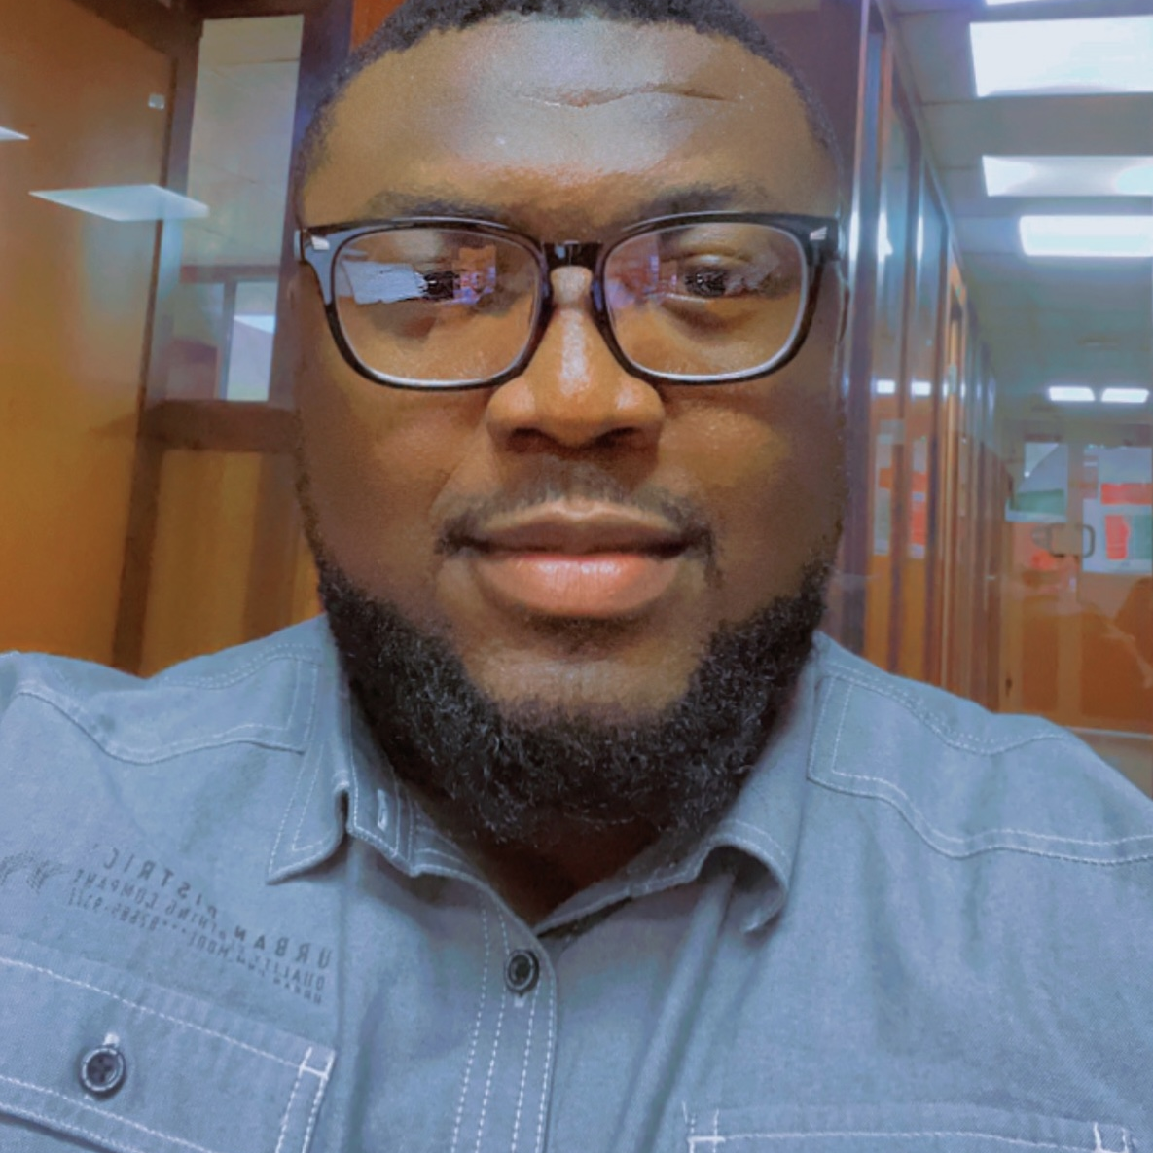
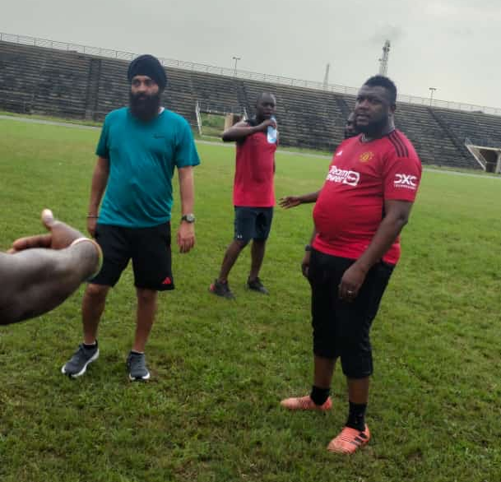
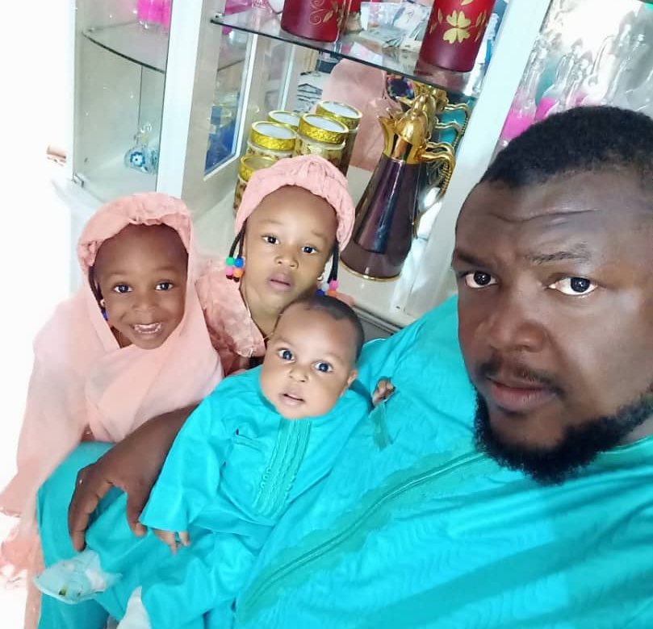
Getting to Know Me
Work
Personal
My role
Branch Manager
Significant others / family members / furry friends in my life
My children, Mr. Inderjit and Hamza Sheriff
Tenure in ofi/Olam
3 Years 4 Months
How I enjoy spending my free time
Playing & watching football, Family time
Previous companies I have worked at
Unilever Nig Plc, Reckitt Benckiser, The Lacasera Company
My favorite / comfort food
African dish, Tuwo miyar kuka
Why I joined ofi/Olam and what keeps me here?
It wasn’t a just Job, but a calling. The culture is second to none
My favorite song
Farkon mafadi – by Fadar bege
Mohammed Bashir Musa
‘Bash’
A few fun facts about me
Being myself and love Nature
This is me outside work, doing stuff I enjoy in my life …

